Slide 1
How to use this presentation
This slide is not for external use. Please delete before using with a customer.
This presentation is designed to help guide your deployment architecture conversations with MuleSoft customers, partners, prospects, and our ecosystem
This presentation is modular and includes deployment diagrams across all runtime plane deployment.
The outline is as follows:
Terminology
Runtime Plane Architectures
Anypoint CloudHub
Anypoint Mule Runtime (Standalone)
Anypoint Runtime Fabric
Anypoint Service Mesh
Anypoint Private Cloud Edition
Presenting this deck? First make a copy of this master.
Sending these slides? First make a copy of this master, then download a PDF of the slides.
Questions?
This presentation is maintained by the Deployment Guide Initiative team. Please send any questions to #deployment-guide on Slack.

Slide 2
Anypoint Platform Deployment Architecture
Runtime Plane Guidebook v1.0
Nov. 2020

Slide 3
Table of contents
Fundamentals
Deployment Options
Deployment in a typical SE engagement
Terminology
Deployment Options
Deployment Models
Anypoint CloudHub
Anypoint Runtime Standalone
Anypoint Runtime Fabric
Anypoint Service Mesh
Anypoint Runtime Standalone - PCE
Choosing the right option

Slide 4
Deployment in a typical SE engagement
STEP 1
Customer/prospect request
on NEW OPPORTUNITY
STEP 2
Deployment Option Selection
STEP 3
Performance & Sizing
What are customer needs?
Did they arrives with something in mind (ie ServiceMesh?)
Does customer strongly ask for an option?
What is the best deployment option that fulfills the customer needs?
Do we need to reframe them on other option/s?
What should we consider when sizing the deployment option?
Are there NFR capabilities to take into consideration?
Is there a budget ($$) restriction?
This guide helps here

Slide 5
Terminology

Slide 6
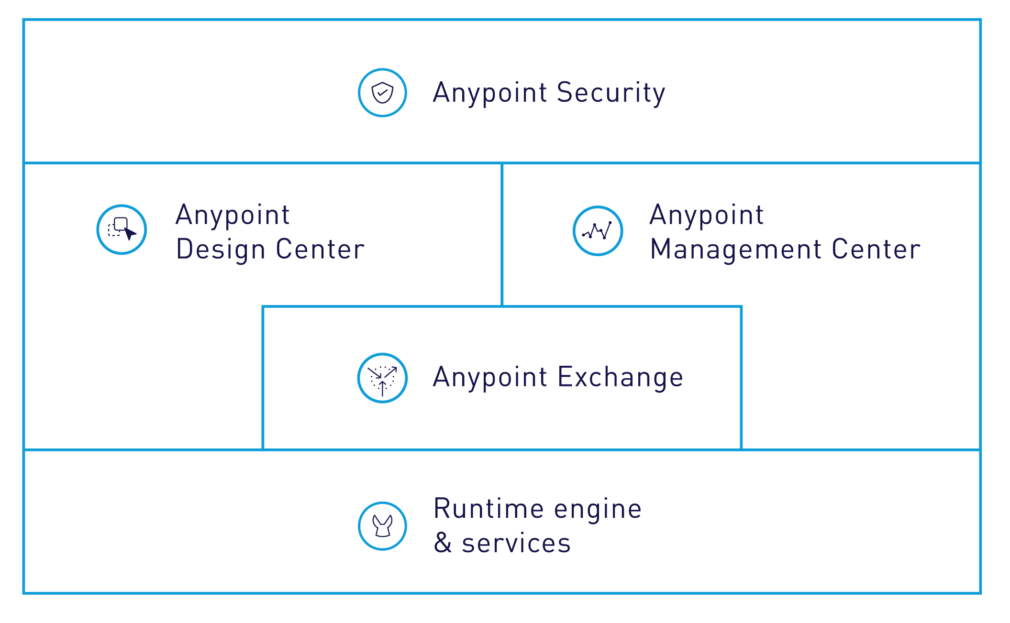
MuleSoft’s Anypoint Platform
Deployment Architecture
Control Plane
Runtime Plane

Slide 7



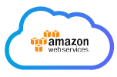
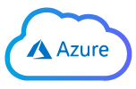
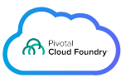

MuleSoft’s Anypoint Platform
Deployment Architecture: Runtime Plane
Runtime Plane
On-premises
& private cloud
Hybrid
Hosted
by MuleSoft
Cloud service providers

Slide 8
Deployment Options
Cost of Ownership
Managed by MuleSoft | MuleSoft provides hosting services for the Anypoint Platform including patching and provisioning of software and uptime based on contractual SLAs, where the hosting environment is Amazon Web Services (AWS).
Managed by the Customer (Data center) | MuleSoft provides software componentry of the Anypoint Platform. The customer is responsible for patching and provision and managing internal uptime SLAs, where the hosting environment is the customer’s data center.
Managed by the Customer (3rd party Cloud) | MuleSoft provides software componentry of the Anypoint Platform. The customer is responsible for patching and provision and managing internal uptime SLAs, where the hosting environment is a 3rd Party Cloud (e.g. AWS, Azure, Google) the customer has contracted with for hosting services.

Slide 9
Deployment Models
 | CloudHub (Commercial/GovCloud) | Hybrid (Commercial/GovCloud) | On-premise (Private Cloud Edition)
Control Plane
Runtime Plane
Managed by MuleSoft
Managed by the Customer (Data center)
Managed by the Customer (3rd party Cloud)

Slide 10
CloudHub
Runtime Plane Deployment Architecture

Slide 11
Deployment Models
Cloud
 | CloudHub (Commercial/GovCloud) | Hybrid (Commercial/GovCloud) | On-premise (Private Cloud Edition)
Control Plane
Runtime Plane
Managed by MuleSoft
Managed by the Customer (Data center)
Managed by the Customer (3rd party Cloud)

Slide 12




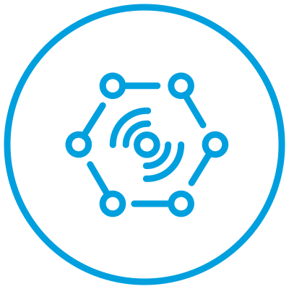












Anypoint CloudHub
Internal & External APIs
Anypoint Platform
API-led connectivity for microservices
MANAGEMENT
CENTER
ACCESS MANAGEMENT
RUNTIME MANAGER
VISUALIZER
ADVANCE MONITORING
EXCHANGE
API ANALYTICS
DESIGN
CENTER
API DESIGNER
PARTNER
MANAGER`
Runtime Plane
Worker
Worker
Worker
Worker
Worker
Worker
App
App
App
App
App
App
CLOUDHUB
Mule
Mule
Mule
Mule
Mule
Mule
Notes:
CloudHub is a complete integration platform as a service (iPaaS) that provides server functionality for you to deploy your apps without having to configure a hosting environment and all the benefits that our platform brings such as single management plane, resiliency, valuable insights and built in security with full automation and orchestration

Slide 13








Anypoint CloudHub Architecture
SHARED/DEDICATED LOAD BALANCER
HTTP/S
Worker
Worker
Worker
App
App
App
mTLS
MANAGEMENT CENTER
Mule
Mule
Mule
RUNTIME MANAGER
mTLS
API MANAGER
mTLS
ADVANCED MONITORING
mTLS
RUNTIME PLANE
CloudHub VPC
CloudHub Region
Notes:
Let’s take a look at the CloudHub architecture. An external TCP load balancer to spread inbound traffic to the right pod on the right worker.
The agents communicate with ARM to provide update on cluster status and also pull updates from management center. Application provides metrics/logs to the platform to allows powerful insights
Keep in mind that all traffic are secure and initiated from the fabric. No traffic is initiated by MS management plane

Slide 14




Application Deployment with CloudHub
1
DESIGN CENTER
2
Anypoint Studio
EXCHANGE
1
Implementation
Build/Upload artifact
Trigger Deployment
Retrieve artifact
Pull CloudHub Worker
2
Mule Maven Plugin
3
4
3
4
RUNTIME MANAGER
5
5
Anypoint CloudHub
Worker
Worker
App
App
Mule
Mule
Notes:
Assuming that you are familiar with designing, building, testing mule applications. The next natural step is to deploy your app to RTF. There are a couple of ways to do this
Deploy manually from ARM by uploading your artifact or pulling it from Exchange (that was previously published/uploaded) (step 1, 2, 3, 4, and 5)
Use the mule mvn plugin to deploy: the plug in build, test (step 3), The app will then be uploaded and deployed in CH worker(s) (step 5). This can be incorporated into CI/CD tools like Jenkins, Travis, Bamboo….

Slide 15




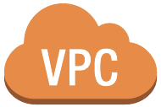





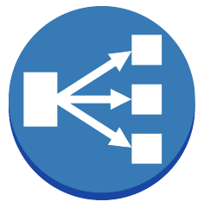











Anypoint VPC Architecture
HTTP/S
Client
[cloudhub.io]
CloudHub Domain Name
[cloudhub.io]
CloudHub Domain Name
Region
[us-e2]
Region
[us-e2]
AWS Region
AWS Region
Production Customer VPC [10.100.1.0/24]
Dedicated Load Balancer
[my-dlb.lb.anypointdns.net]
Non-Production Customer VPC [10.200.1.0/24]
Dedicated Load Balancer
[my-dlb.lb.anypointdns.net]
appLucy
appLucy
appEthel
appLucy
appLucy
appEthel
Mule Worker
Mule Worker
Mule Worker
Mule Worker
Mule Worker
Mule Worker
Virtual Private Gateway
Shared Load Balancer
[us-e2.cloudhub.io]
Virtual Private Gateway
Shared Load Balancer
[us-e2.cloudhub.io]
VPC Peering
Prod Corporate Data Center
Anypoint VPN
Non-Prod Corporate Data Center
Secure Zone
Secure Zone
AWS Direct Connect
Customer Gateway
Customer Gateway
Firewall
Firewall

Slide 16





Anypoint CloudHub Deployment
Platform Benefits
Zero infrastructure & configuration
Seamless upgrades
Secure Managed Infrastructure
Built-in observability
Built-in scalability
Notes:
Avneet...Sergey and I discussed this, how do you feel about “Secure Managed Infrastructure”?
Or Secure Managed Infrastructure and Configurable Features
Scalability
High availbility

Slide 17
**INTERNAL** Anypoint CloudHub Considerations
This slide is not for external use. Please delete before using with a customer.
Application considerations
Performance considerations
This slide is internal only: Delete or Skip/hide this slide before presenting
Sending these slides? Delete this slide before sending
Questions?
This presentation is maintained by the Deployment Guide Initiative team. Please send any questions to #deployment-guide on Slack.

Slide 18
Anypoint Mule Runtime Standalone
Runtime Plane Deployment Architecture

Slide 19
Deployment Models
Hybrid
 | CloudHub (Commercial/GovCloud) | Hybrid (Commercial/GovCloud) | On-premise (Private Cloud Edition)
Control Plane
Runtime Plane
Managed by MuleSoft
Managed by the Customer (Data center)
Managed by the Customer (3rd party Cloud)

Slide 20
Anypoint Mule Runtime Standalone
Internal & External APIs
Anypoint Platform
API-led connectivity for microservices
MANAGEMENT
CENTER
ACCESS MANAGEMENT
RUNTIME MANAGER
VISUALIZER
ADVANCE MONITORING
EXCHANGE
API ANALYTICS
DESIGN
CENTER
API DESIGNER
PARTNER
MANAGER`
Mule Cluster/Server Group
Server
Server
Server
Server
Server
Server
App
App
App
App
App
App
App
App
App
App
App
App
Mule
Mule
Mule
Mule
Mule
Mule
Notes:
Standalone Mule deployment provides you the ability to host and deploy applications on premises in your data center or private cloud with all the benefits of centrally managing the applications and runtimes from the single management plane. Customer is responsible for the installation and configuration of the Mule runtime engine instances that run the Mule applications.

Slide 21
Anypoint Mule Runtime Standalone Architecture
LOAD BALANCER
HTTP/S
Server
Server
Server
mTLS
App
App
App
Mule
Mule
Mule
MANAGEMENT CENTER
mTLS
RUNTIME MANAGER
API MANAGER
App
App
App
Mule
Mule
Mule
ADVANCE MONITORING
mTLS
mTLS
STANDALONE MULE
Notes:
Let’s take a look at the architecture An external TCP load balancer provided and hosted by the customer that will route traffic to the right server.
The agents communicate with ARM to provide update on cluster status and also pull updates from management center. Application provides metrics/logs to the platform to allows powerful insights
Keep in mind that all traffic are secure and initiated from the Mule Runtime plane. No traffic is initiated by MS management plane
See https://docs.mulesoft.com/mule-runtime/3.9/hardware-and-software-requirements for latest HW/SW requirements

Slide 22
Anypoint Mule Runtime Standalone Architecture
LOAD BALANCER
HTTP/S
Server
Server
Server
mTLS
App
App
App
Mule
Mule
Mule
MANAGEMENT CENTER
mTLS
RUNTIME MANAGER
API MANAGER
App
App
App
Mule
Mule
Mule
ADVANCE MONITORING
mTLS
mTLS
Mule Cluster/Server Group
STANDALONE MULE
Notes:
Mule servers can be group together in a group where deployment will be on all servers. If the apps need to share state, the servers can be configured in cluster mode

Slide 23
Application Deployment with Mule Runtime Standalone
1
DESIGN CENTER
2
Anypoint Studio
EXCHANGE
1
Implementation
Build/Test
Trigger Deployment
Retrieve artifact
(optional)
Deploy to target
2
4
Mule Maven Plugin
2
3
4
RUNTIME MANAGER
Anypoint Standalone Mule
5
Server
Server
3
App
App
App
App
Mule
Mule
Mule
Mule
5
Notes:
Assuming that you are familiar with designing, building, testing mule applications. The next natural step is to deploy your app to RTF. There are a couple of ways to do this
Deploy manually from ARM by uploading your artifact or pulling it from Exchange (that was previously published/uploaded) (step 1, 2 (optional), 3, 4 (optional), and 5)
Use the mule mvn plugin to deploy: the plug in build, test (step 3) , then trigger the deployment with ARM to deploy applications to the right target (server group/cluster) (step 5). This can be incorporated into CI/CD tools like Jenkins, Travis, Bamboo….

Slide 24
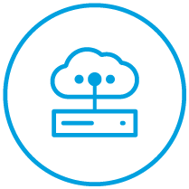
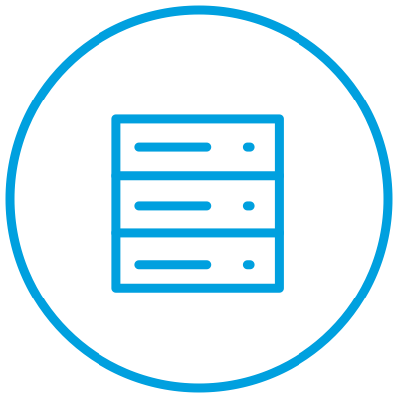
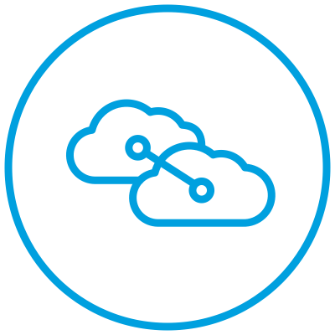
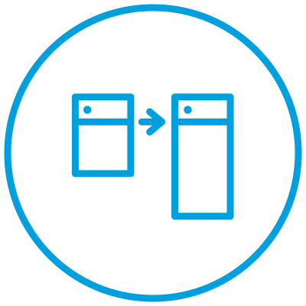
Mule Runtime Standalone - Platform Benefits
Data Proximity
Container & VM choices
Multi-cloud support
Future proof architecture
Resource & Application Monitoring
Notes:
Integrations can run in same data center as customer applications, Satisfies potential data sovereignty issues
Deploy on VM, bare metal, Configurable HA and clustering
Deployment flexibility across any cloud (Azure & AWS) or data center
Connect to the control plane hosted by MuleSoft
Runtime Manager Monitoring:
Classic Application Monitoring
Server/Groups/Cluster Monitoring dashboard

Slide 25
**INTERNAL** Anypoint Mule Runtime Standalone Considerations
This slide is not for external use. Please delete before using with a customer.
Installation readiness - Always check docs.mulesoft.com for latest information
Application considerations
Performance considerations
This slide is internal only: Delete or Skip/hide this slide before presenting
Sending these slides? Delete this slide before sending
Questions?
This presentation is maintained by the Deployment Guide Initiative team. Please send any questions to #deployment-guide on Slack.

Slide 26
Anypoint Runtime Fabric
Runtime Plane Deployment Architecture

Slide 27
Deployment Models
Hybrid
 | CloudHub (Commercial/GovCloud) | Hybrid (Commercial/GovCloud) | On-premise (Private Cloud Edition)
Control Plane
Runtime Plane
Managed by MuleSoft
Managed by the Customer (Data center)
Managed by the Customer (3rd party Cloud)

Slide 28

Anypoint Runtime Fabric
Internal & External APIs
Anypoint Platform
API-led connectivity for microservices
MANAGEMENT
CENTER
ACCESS MANAGEMENT
RUNTIME MANAGER
VISUALIZER
ADVANCE MONITORING
EXCHANGE
ANYPOINT
SECURITY
DESIGN
CENTER
API DESIGNER
PARTNER
MANAGER`
Anypoint Runtime Fabric
Server
Server
Server
Server
Server
Server
App
App
App
App
App
App
App
App
App
App
App
App
Mule
Mule
Mule
Mule
Mule
Mule
Mule
Mule
Mule
Mule
Mule
Mule
Runtime Fabric services
Docker & Kubernetes (nodes)
Notes:
Anypoint Runtime fabric is essentially our cloud offering (CH) rolls into an appliance that takes away the complexity of installing/maintaining/managing your own runtimes, with all the benefits that our platform brings such as single management plane, resiliency, valuable insights and built in security with full automation and orchestration, in your own private, protected network

Slide 29

Anypoint Runtime Fabric Architecture
TCP LOAD BALANCER
HTTP/S
Controller
Controller
Controller
Ingress
Ingress
Ingress
Agent
Agent
Agent
mTLS
MANAGEMENT CENTER
mTLS
RUNTIME MANAGER
CONTAINER REGISTRY
replicas
ADVANCED MONITORING
Worker
Worker
Worker
App1
App2
App1
App2
App1
App2
Mule
Mule
Mule
Mule
Mule
Mule
mTLS
App3
App4
App3
App4
App3
App4
Mule
Mule
Mule
Mule
Mule
Mule
mTLS
RUNTIME FABRIC
Notes:
Let’s take a look at the architecture of a minimal production construct: 3 controllers, 3 workers to ensure redundancy and HA. An external TCP load balancer to spread inbound traffic to the ingress on the controllers that will route traffic to the right pod on the right worker.
The agents communicate with ARM to provide update on cluster status and also pull updates from management center. Both RTF components and Mule app download images and updates (when available and chosen to do so by customer) from the container registry. Application provides metrics/logs to the platform to allows powerful insights
Keep in mind that all traffic are secure and initiated from the fabric. No traffic is initiated by MS management plane
See https://docs.mulesoft.com/runtime-fabric/1.7/install-prereqs for latest HW/SW requirements

Slide 30
Application Deployment with Runtime Fabric
1
DESIGN CENTER
2
Anypoint Studio
EXCHANGE
1
Implementation
Build/Upload artifact
Trigger Deployment
Retrieve artifact
Pull Runtime Docker Image
2
2
4
Mule Maven Plugin
3
3
4
RUNTIME MANAGER
Anypoint Runtime Fabric
5
Server
Server
3
App
App
App
App
Mule
Mule
Mule
Mule
Runtime Fabric services
CONTAINER REGISTRY
Docker & Kubernetes (nodes)
5
Notes:
Assuming that you are familiar with designing, building, testing mule applications. The next natural step is to deploy your app to RTF. There are a couple of ways to do this
Deploy manually from ARM by uploading your artifact or pulling it from Exchange (that was previously published/uploaded) (step 1, 2, 3, and 4)
Use the mule mvn plugin to deploy: the plug in build, test and publish the app to exchange (step 1 and 2) , then trigger the deployment with ARM that will pull the artifact from Exchange (Step 3 and 4). The app will then be baked into appropriate mule runtime image that is either already available on worker nodes or freshly pulled from the registry (step 5). This can be incorporated into CI/CD tools like Jenkins, Travis, Bamboo….

Slide 31
Anypoint Runtime Fabric - Platform Benefits
Data Proximity
Simplify infrastructure with Docker and Kubernetes
Multi-cloud support
Future proof architecture
Resource & Application Monitoring
Notes:
Along with standard platform benefits, Runtime Fabric allows
Deploy and manage runtimes anywhere
Central application management with Anypoint Management Center
Simple and automated runtime provisioning (with Kubernetes and Docker)

Slide 32
**INTERNAL** Runtime Fabric Considerations
This slide is not for external use. Please delete before using with a customer.
Installation readiness - Always check docs.mulesoft.com for latest information
Application considerations
Performance considerations
This slide is internal only: Delete or Skip/hide this slide before presenting
Sending these slides? Delete this slide before sending
Questions?
This presentation is maintained by the Deployment Guide Initiative team. Please send any questions to #deployment-guide on Slack.

Slide 33
AWS vs. Azure vs. GCP
 | AWS | Azure | GCP (and others)
 | RTF installation process on any cloud platform is similar (Think of it as if you were going to install RTF manually) The differences lie in how the infrastructure is built and is it supported by Mulesoft Currently Mulesoft supports automation for AWS and Azure. For any other cloud providers, treat as manual installation
Infra. automation | Yes | Yes | No. Treat as manual installation
Automation tool(s) | Terraform (native and containerized) | ARM (Azure Resource Manager) template | No
Notes:
The installation of RTF is comprised of 2 parts: Infrastructure preparation and RTF installation. You will need the privileges to create resources (VMs, Disk, LB, ….) regardless of cloud platform you work with.
We have automation support for AWS and Azure.

Slide 34




Anypoint Runtime Fabric - Where does it fit?
Existing cloud infrastructure
Ongoing kubernetes initiatives
Need for automation and isolation
Highly restricted industries
Customer has an AWS or Azure instance, and can leverage RTF on their infrastructure, in some cases with hybrid cloud.
RTF is built on kubernetes, and is attractive to customers that have kubernetes initiatives within their org.
Current on-premises deployments are requiring dedicated teams to monitor and orchestrate deployments.
Customers in industries such as finance or government want managed cloud benefits but can only deploy on-premises.
Notes:
Let’s look at some scenarios where Runtime Fabric has done well with customers.
Everyone wants to move to the cloud these days, and so a number of companies have invested heavily in cloud infrastructure. They may have spent a lot of money on their own AWS or Azure instance, and want to leverage it. RTF is a logical way for them to do that, as they can deploy their runtimes to their own cloud while maintaining their managed cloud benefits.
Several organizations today are interested in Docker, Kubernetes, and containerization initiatives. Interesting thing here, containerization is really a concept thats about 5-6 years old, yet is being adopted at an alarming rate. Companies find it very difficult to find skilled resources that can help them accomplish their desired kubernetes initiatives. RTF is built on Kubernetes, and so the customer can accomplish their containerization initiatives without any need for dedicated teams that know Docker or Kubernentes.
Number of on premise customers have the need to automate their deployments, isolate their applications, and scale to get the resources they need. This usually means spending a lot of money on manual efforts. But with RTF, customers get these benefits OOTB. They don’t have any manual efforts.
Finally, some customers are in restricted industries, such as government or finance. They want managed cloud benefits, but cannot deploy to CloudHub or a private cloud. Here, RTF is an easy way for them to get their managed cloud benefits on their own premises.
With all these very successful scenarios that we have seen, we would like to remind you once again….

Slide 35
Anypoint Service Mesh
Runtime Plane Deployment Architecture

Slide 36
Deployment Models
Hybrid
 | CloudHub (Commercial/GovCloud) | Hybrid (Commercial/GovCloud) | On-premise (Private Cloud Edition)
Control Plane
Runtime Plane
Managed by MuleSoft
Managed by the Customer (Data center)
Managed by the Customer (3rd party Cloud)

Slide 37
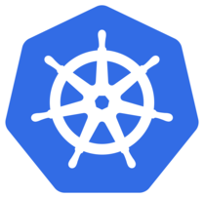

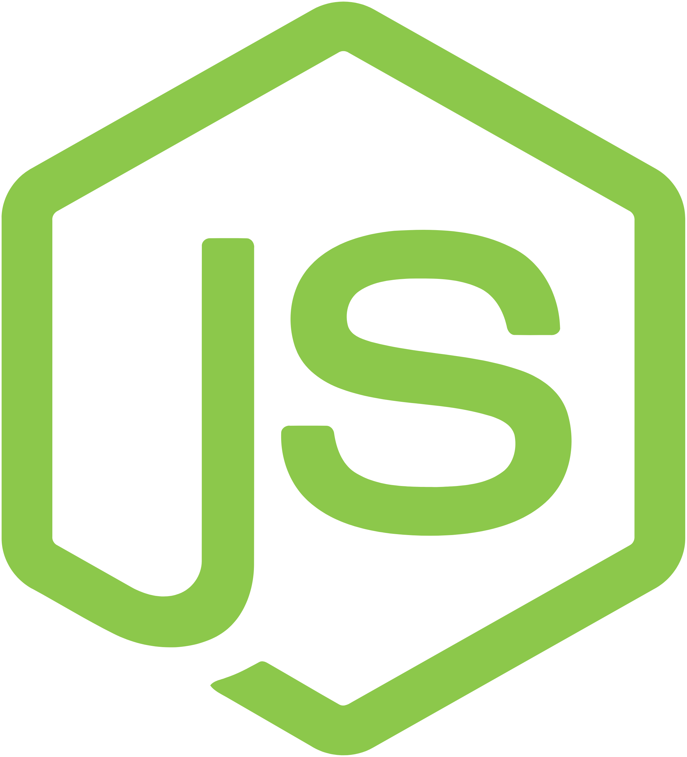



Anypoint Service Mesh
Internal & External APIs
Anypoint Platform
API-led connectivity for microservices
MANAGEMENT
CENTER
ACCESS MANAGEMENT
RUNTIME MANAGER
VISUALIZER
ADVANCED MONITORING
EXCHANGE
ANYPOINT
SECURITY
DESIGN
CENTER
API DESIGNER
PARTNER
MANAGER`
Kubernetes cluster
Mule Adapter
Service A
Service B
Istio
Node.js
Sidecar
proxy
Sidecar
proxy
Notes:
Unlike other options where we mainly talk about managing Mule applications/integrations. Anypoint Service Mesh focuses on existing non-mule services. It enables you to extend your microservices network by including your non-MuleSoft applications into the Anypoint Platform sphere. You can then manage and secure your application network, including your non-Mule applications, seamlessly from a single pane.
Your non-MuleSoft microservices might be written using different languages and platforms, or might be deployed in different environments. To alleviate issues arising from differences in these microservices, Anypoint Service Mesh ensures the following application management advantages:
Provides resilient service-to-service communication (east-west traffic) using zero-trust policies to handle traffic control, fault tolerance and load balancing
Extends MuleSoft API Management capabilities to any non-Mule service, with policies, security and analytics all applied directly from Anypoint Platform
Amplifies reuse of services with discovery of non-Mule services within Exchange, available for use in future projects

Slide 38

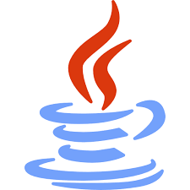
Anypoint Service Mesh Architecture
MANAGEMENT CENTER
API
ANALYTICS
API
MANAGER
EXCHANGE
namespace1
namespace2
Istio
Mule Adapter
Istio
Mule Adapter
Envoy
Envoy
Envoy
Envoy
Service
A
Service
B
Service
C
Service
D
KUBERNETES CLUSTER (AKS/EKS/GKE/OpenShift)
Notes:
ASM uses Istio, the industry de facto ServiceMesh software. You can install ASM by installing Istio on your K8s cluster, then in a namespace that is enabled with Istio, we can install a Mule adaptor to perform contract/policy check and provide metrics, analytics info back to Management Center.
Currently we support managed k8s from GCP, AWS and Azure.

Slide 39
Anypoint Service Mesh Architecture
HTTP/S
1
HTTP/S
1
Envoy
Envoy
3
3
MANAGEMENT CENTER
Service
A
Service
B
EXCHANGE
a
API
ANALYTICS
2
API
MANAGER
b
Mule Adapter
namespace
KUBERNETES CLUSTER (AKS/EKS/GKE/OpenShift)
Notes:
Here is how it works:
The client, which might be another microservice or any Kubernetes Ingress component, sends a request to the service.
Envoy captures the request and redirects it to the MuleSoft adapter using the Envoy filter. The adapter then performs policy checks and verifications. When no policy violations are encountered, the request is routed to the microservice.
The microservice runs the service logic and sends the response back to the client.
Periodically, the adapter communicates with Anypoint Platform asynchronously to get the latest policies and contracts.
Periodically, the adapter returns the API analytics information to Anypoint Platform.
Also, discovered services are available in Exchange which can easily be reused in new projects

Slide 40


Anypoint Service Mesh - Platform Benefits
Extend platform capabilities
Multi-cloud support (EKS/AKS/GKE/OpenShift)
Central application management
Visibility into Enterprise application landscape
Notes:
Extend Anypoint platform capacities to non Mule applications in AKS/EKS
Central application management with Anypoint Management Center
Visibility into enterprise application landscape (both Mule and non Mule)

Slide 41
**INTERNAL** Service Mesh Considerations
This slide is not for external use. Please delete before using with a customer.
Installation Readiness - Always check docs.mulesoft.com for latest information
This slide is internal only: Delete or Skip/hide this slide before presenting
Sending these slides? Delete this slide before sending
Questions?
This presentation is maintained by the Deployment Guide Initiative team. Please send any questions to #deployment-guide on Slack.

Slide 42
Anypoint Private Cloud Edition (PCE)
Runtime Plane Deployment Architecture

Slide 43
Deployment Models
On-premise
 | CloudHub (Commercial/GovCloud) | Hybrid (Commercial/GovCloud) | On-premise (Private Cloud Edition)
Control Plane
Runtime Plane
Managed by MuleSoft
Managed by the Customer (Data center)
Managed by the Customer (3rd party Cloud)

Slide 44
Anypoint Standalone Mule (PCE)
Internal & External APIs
Anypoint Platform
API-led connectivity for microservices
MANAGEMENT
CENTER
ACCESS MANAGEMENT
RUNTIME MANAGER
VISUALIZER
ADVANCED MONITORING
EXCHANGE
API ANALYTICS
DESIGN
CENTER
API DESIGNER
PARTNER
MANAGER`
Anypoint Standalone Mule
Server
Server
Server
Server
Server
Server
App
App
App
App
App
App
App
App
App
App
App
App
Mule
Mule
Mule
Mule
Mule
Mule
Mule
Mule
Mule
Mule
Mule
Mule

Slide 45
Anypoint Standalone Mule (PCE)
Internal & External APIs
Anypoint Platform
API-led connectivity for microservices
MANAGEMENT
CENTER
ACCESS MANAGEMENT
RUNTIME MANAGER
EXCHANGE
DESIGN
CENTER
API DESIGNER
Anypoint Standalone Mule
Server
Server
Server
Server
Server
Server
App
App
App
App
App
App
App
App
App
App
App
App
Mule
Mule
Mule
Mule
Mule
Mule
Mule
Mule
Mule
Mule
Mule
Mule

Slide 46
Anypoint Standalone Mule Architecture (PCE)
TCP LOAD BALANCER
HTTP/S
Server
Server
Server
mTLS
App
App
App
Mule
Mule
Mule
MANAGEMENT CENTER
mTLS
RUNTIME MANAGER
API MANAGER
App
App
App
Mule
Mule
Mule
mTLS
mTLS
STANDALONE MULE
Notes:
Let’s take a look at the Standalone Mule architecture An external TCP load balancer provided and hosted by the customer that will route traffic to the right server.
The agents communicate with ARM to provide update on cluster status and also pull updates from management center. Application provides metrics/logs to the platform to allows powerful insights
Keep in mind that all traffic are secure and initiated from the Mule Runtime plane. No traffic is initiated by MS management plane
See https://docs.mulesoft.com/mule-runtime/3.9/hardware-and-software-requirements for latest HW/SW requirements

Slide 47
Application Deployment with Standalone Mule (PCE)
1
DESIGN CENTER
2
Anypoint Studio
EXCHANGE
1
Implementation
Build/Upload artifact
Trigger Deployment
Retrieve artifact
Pull Standalone Mule
2
2
4
Mule Maven Plugin
3
3
4
RUNTIME MANAGER
Anypoint Standalone Mule
5
Server
Server
3
App
App
App
App
Mule
Mule
Mule
Mule
5
Notes:
Assuming that you are familiar with designing, building, testing mule applications. The next natural step is to deploy your app to RTF. There are a couple of ways to do this
Deploy manually from ARM by uploading your artifact or pulling it from Exchange (that was previously published/uploaded) (step 1, 2, 3, and 4)
Use the mule mvn plugin to deploy: the plug in build, test and publish the app to exchange (step 1 and 2) , then trigger the deployment with ARM that will pull the artifact from Exchange (Step 3 and 4). The app will then be baked into appropriate mule runtime image that is either already available on worker nodes or freshly pulled from the registry (step 5). This can be incorporated into CI/CD tools like Jenkins, Travis, Bamboo….

Slide 48
Mule Runtime Standalone (PCE) - Platform Benefits
Data Proximity
Container & VM choices
Full control over infrastructure
High Security needs
Resource & Application Monitoring
Notes:
Integrations can run in same data center as customer applications, Satisfies potential data sovereignty issues
Deploy on VM, bare metal, Configurable HA and clustering
High impact levels and High Data Security needs
Runtime Manager Monitoring:
Classic Application Monitoring
Server/Groups/Cluster Monitoring dashboard

Slide 49
**INTERNAL** Anypoint Private Cloud Edition Considerations
This slide is not for external use. Please delete before using with a customer.
Installation readiness - Always check docs.mulesoft.com for latest information
Application considerations
This slide is internal only: Delete or Skip/hide this slide before presenting
Sending these slides? Delete this slide before sending
Questions?
This presentation is maintained by the Deployment Guide Initiative team. Please send any questions to #deployment-guide on Slack.

Slide 50
Choosing the Right Deployment Option

Slide 51
Deployment Model : Decision Tree
Commercial Cloud
All Features
Most preferred
Very Low IT Overhead
Commercial Cloud Hybrid
RTF (Preferred)
Customer Managed Runtimes
Comm. Cloud Control Plane
App Data remains on-premise
Metadata in Comm. Cloud
GovCloud
Mulesoft Managed Runtimes and Control Plane
OOTB Security and Compliance with FedRamp Moderate
Partial Feature Set
Targets: FedCiv and some DoD workloads
GovCloud Hybrid
Customer Managed Runtimes
MuleSoft Managed Control Plane
Strict PII/PHI requirements
Targets: FedCiv and DoD workloads
PCE
Customer Managed Runtimes and Control Plane
Services SOW and approvals required
High IT Overhead
Targets: IC/DoD workloads with Strict app/metadata requirements
Standalone Mule
Customer Managed Runtimes
No Control Plane
Integration Only Use Cases
Targets: IC/DoD workloads

Slide 52
Q & A

Slide 53

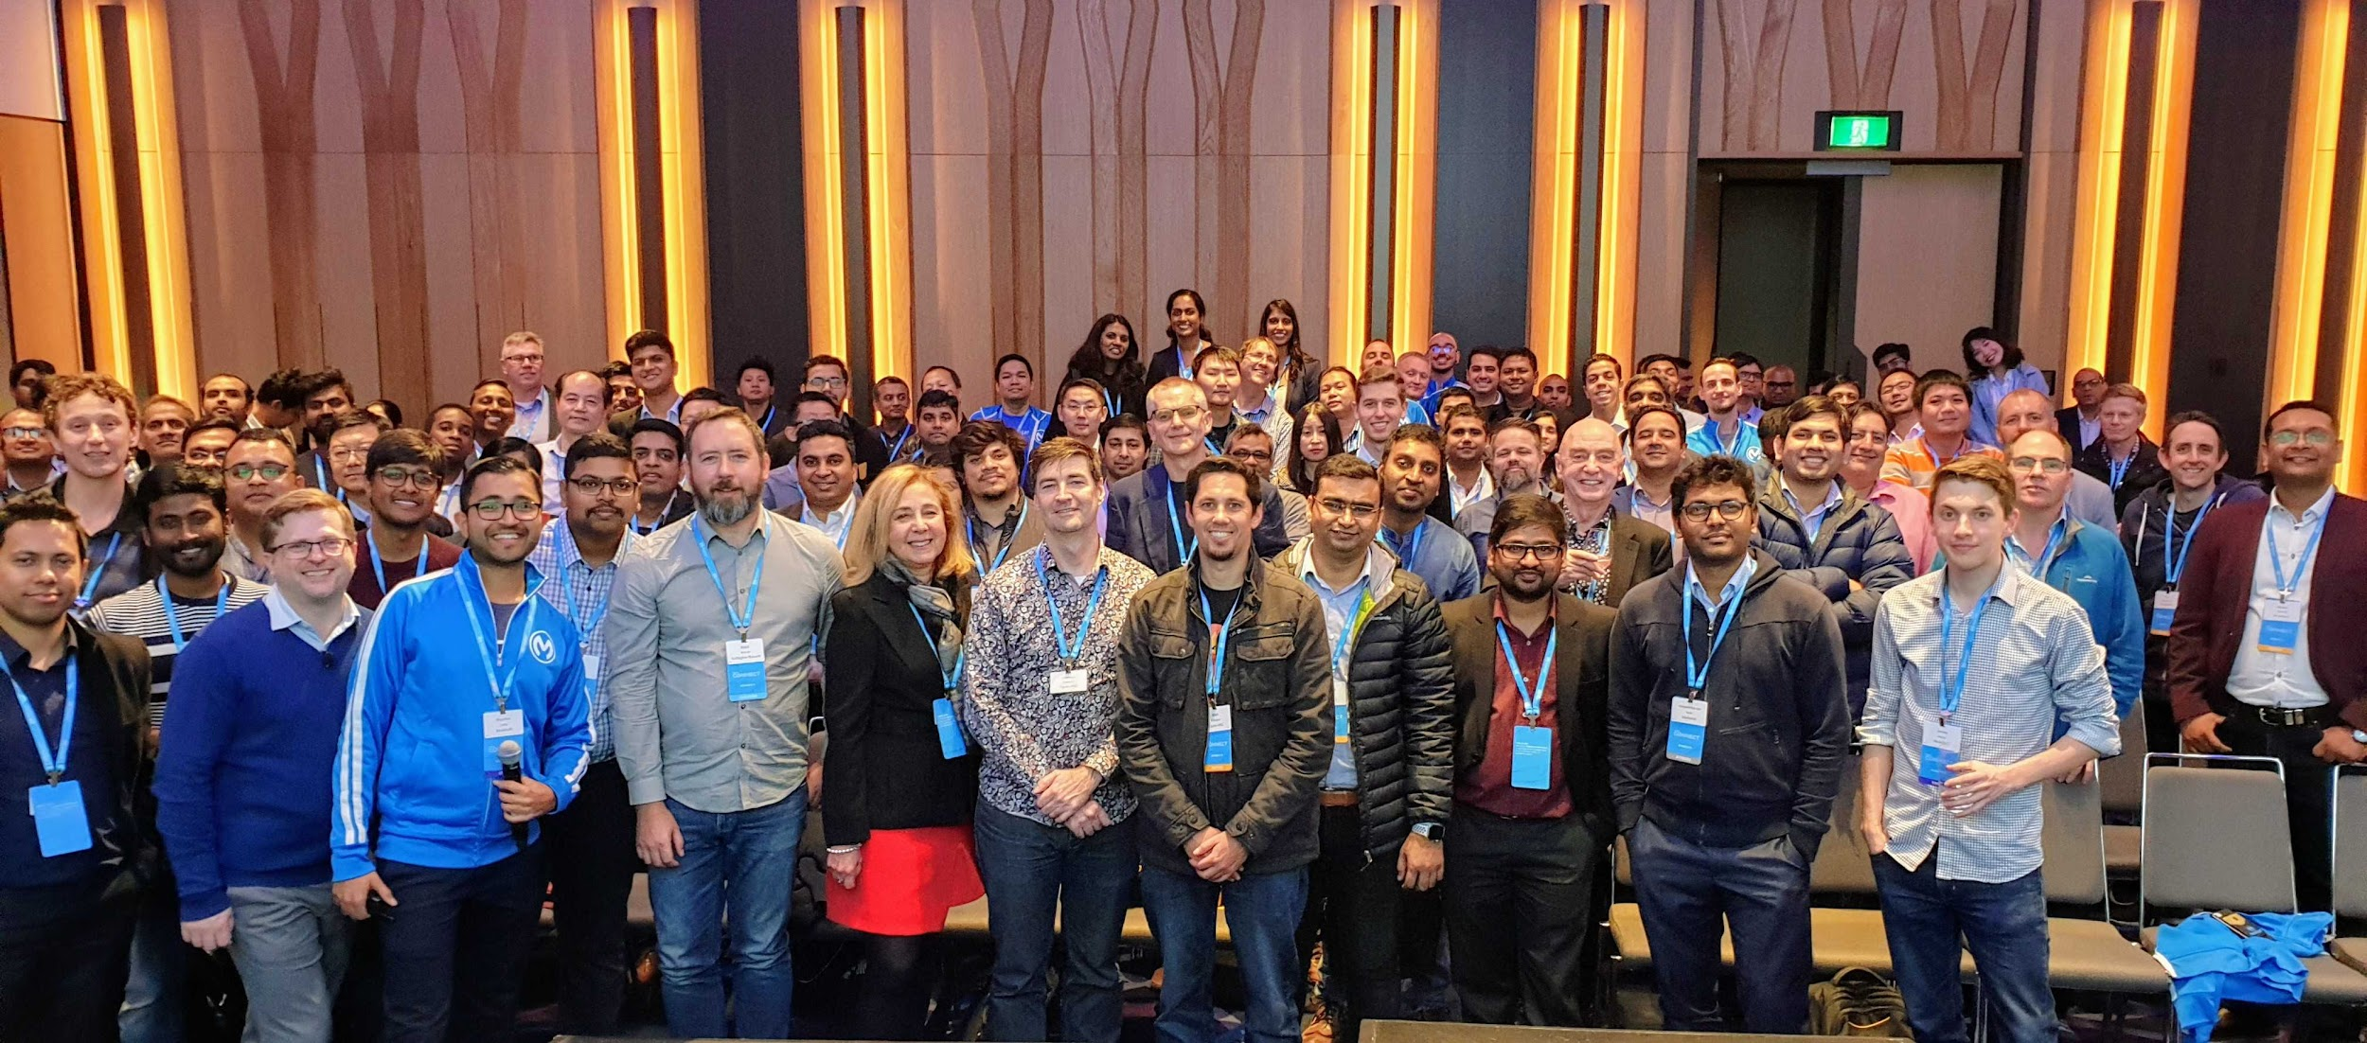
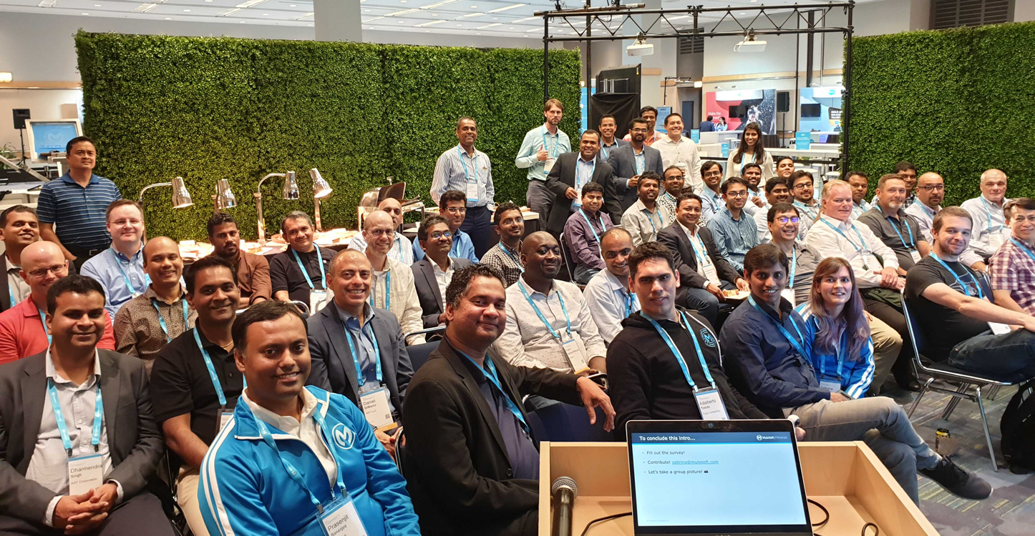
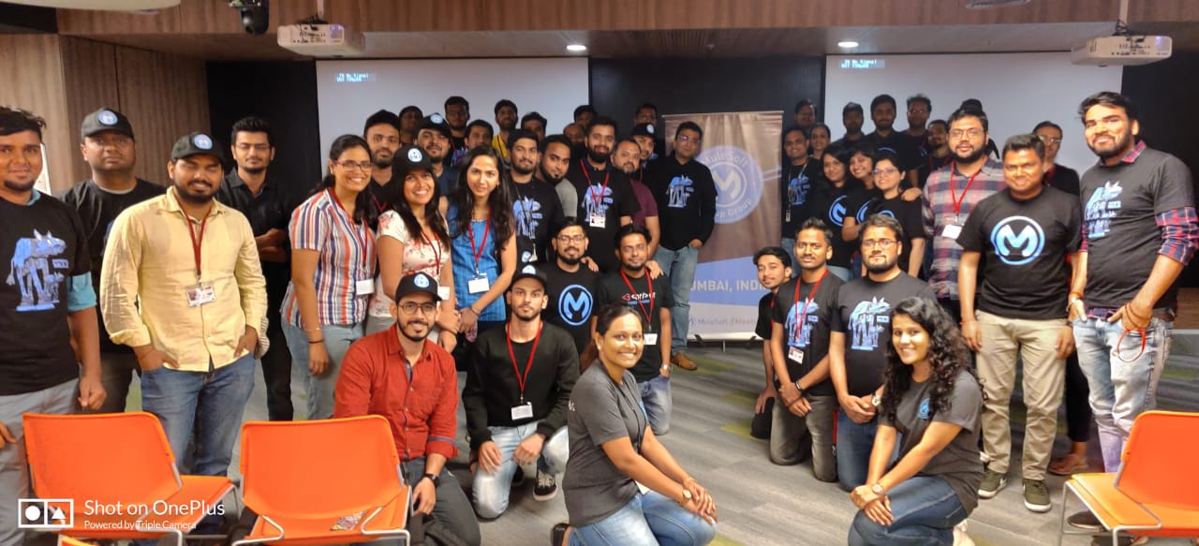
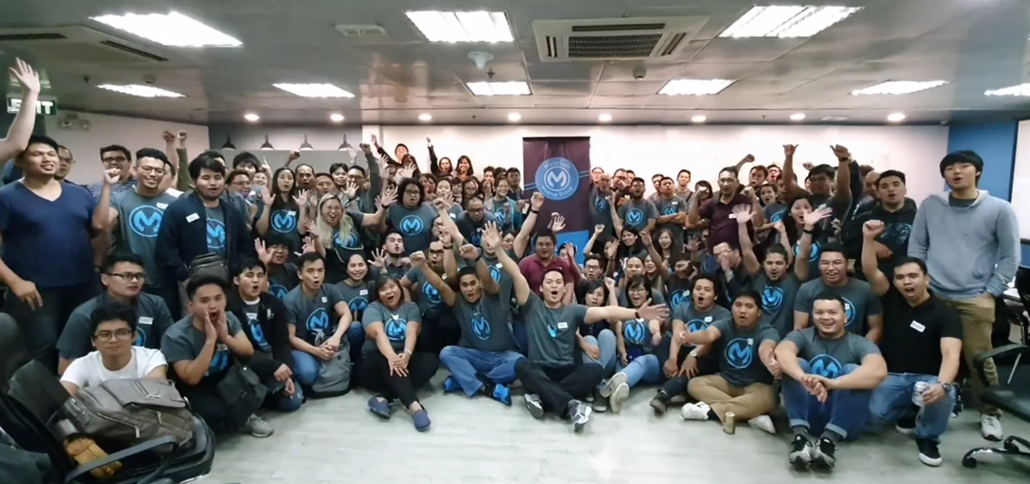

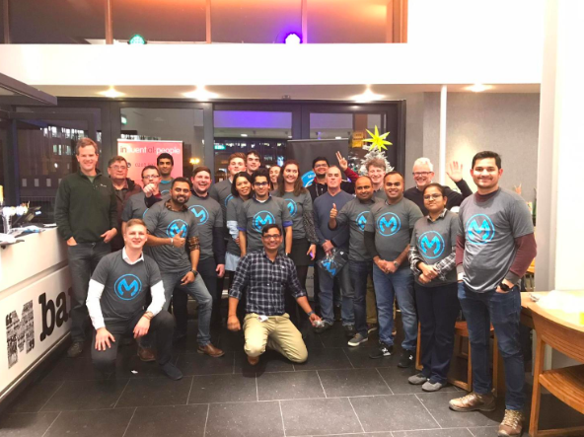


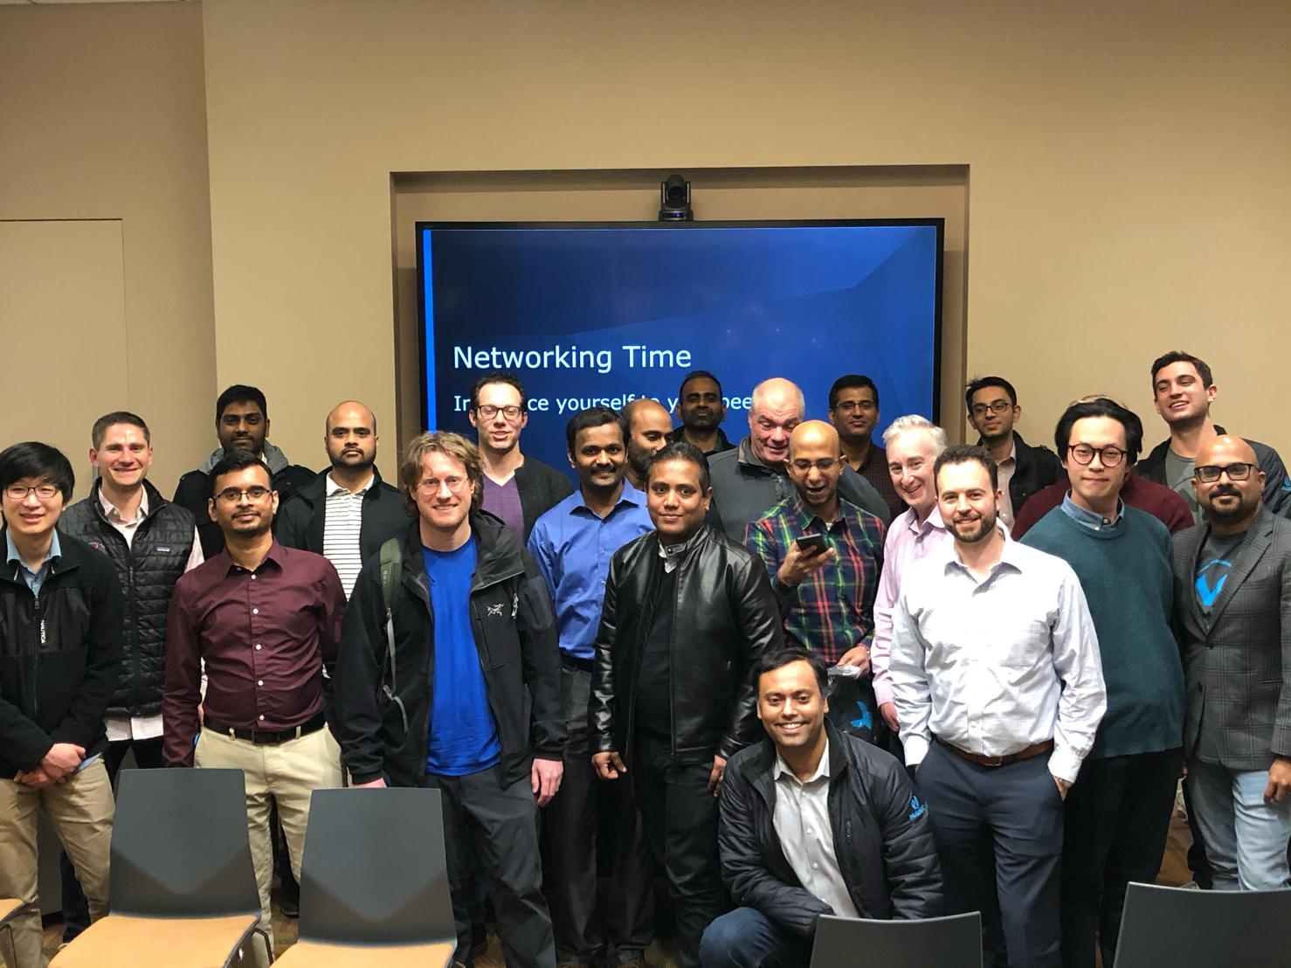
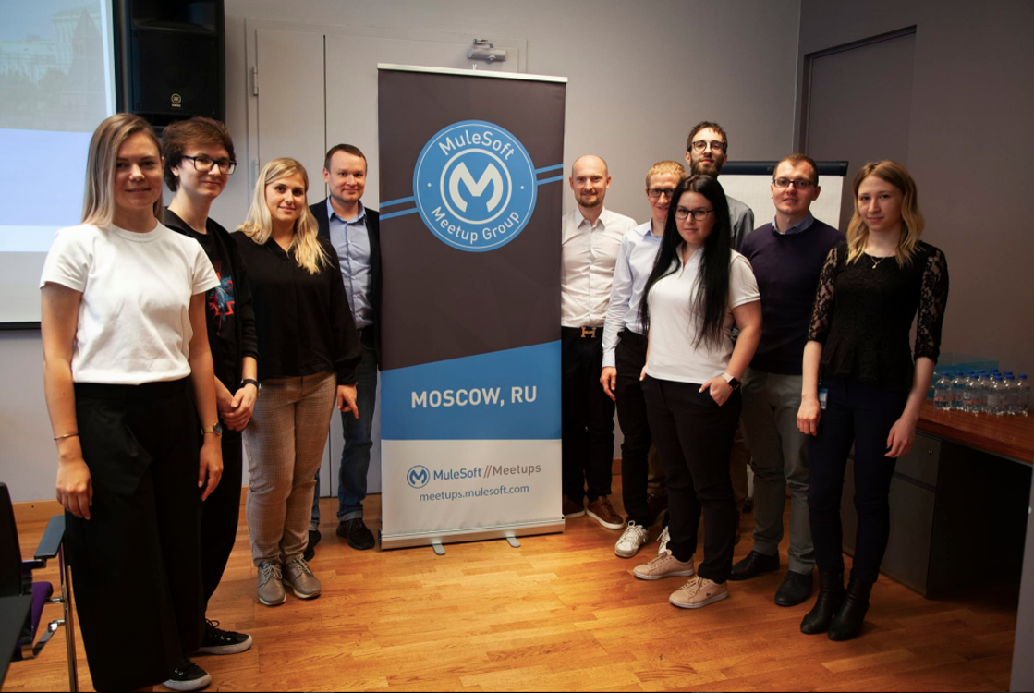





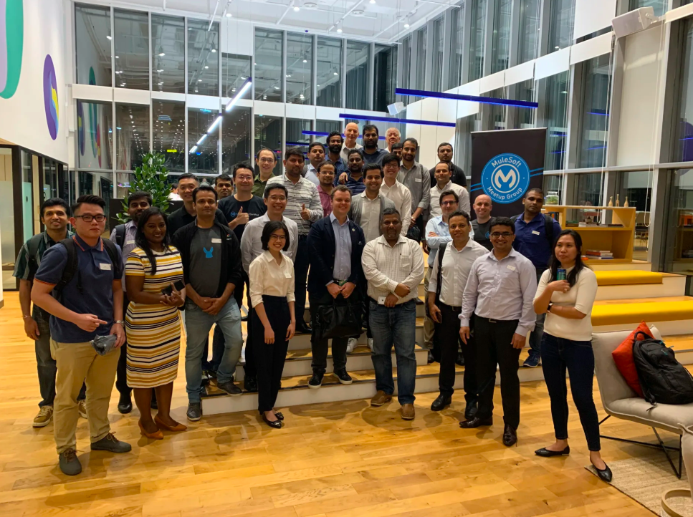
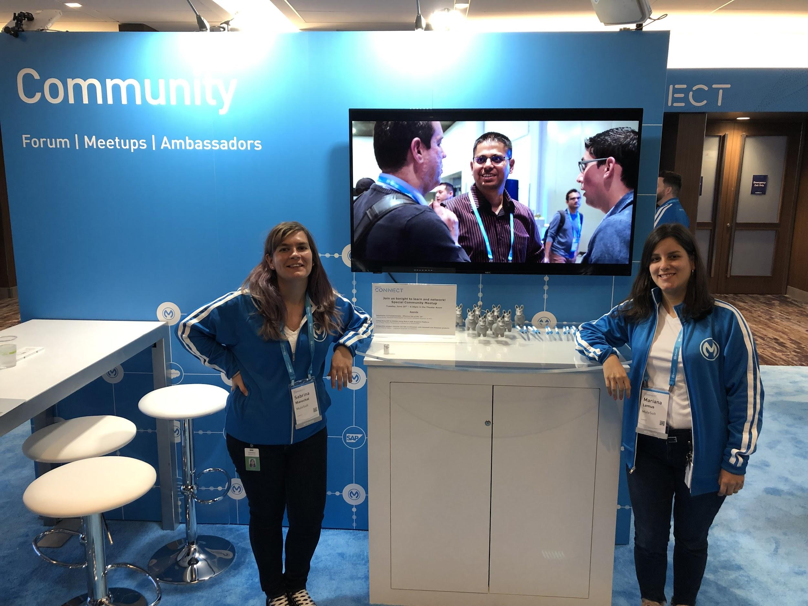
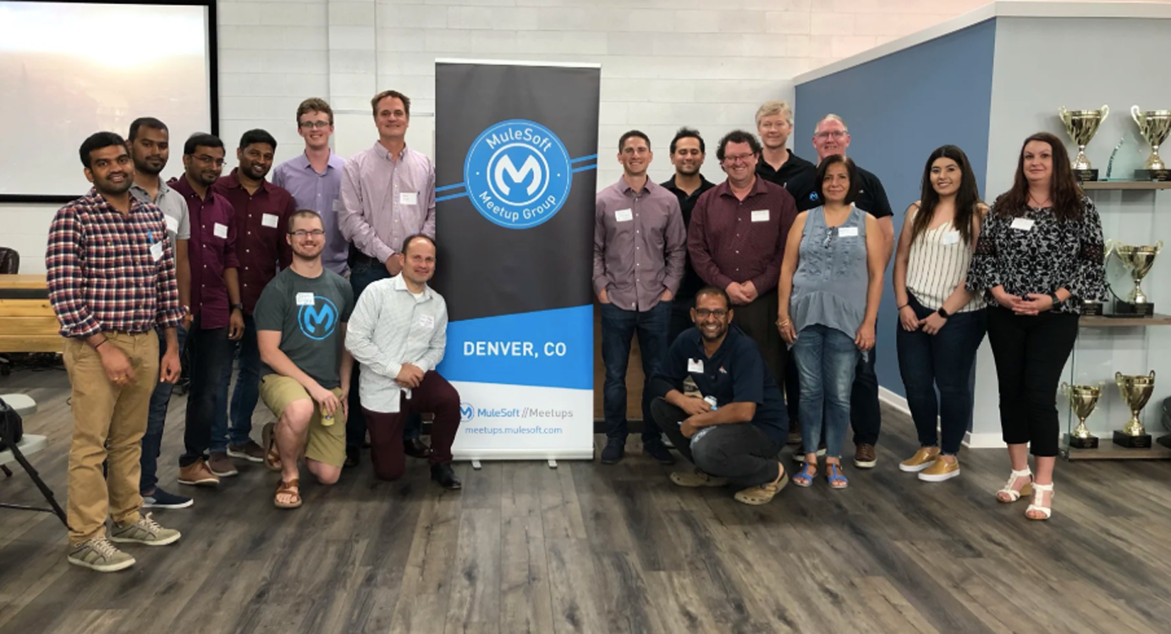
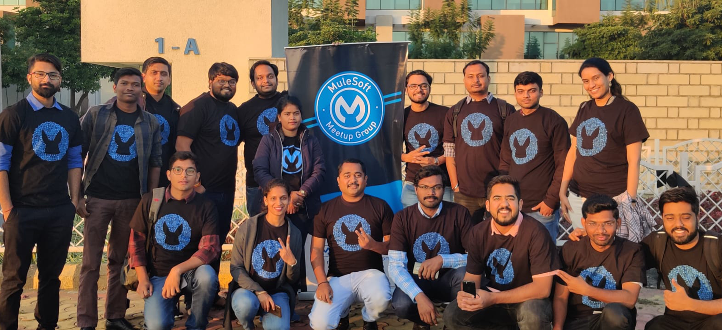

Thank you

